Slide 1
US Bicyclist Fatalities
Melanie Adams, Jodie Carlson,
Sam Etten, Norean Gardner,
and Brian Rolf

Slide 2
Data Set
A primary objective of the National Highway Traffic Safety Administration (NHTSA) is to reduce fatal motor vehicle traffic crashes. An initiative created by NHTSA is to collect data to support the development, implementation, and assessment of highway traffic to reduce fatalities.
Data points in the set: To qualify as a FARS (Fatality Analysis Reporting System) case, the crash had to involve a motor vehicle traveling on a trafficway customarily open to the public, and must have resulted in the death of a motorist or a non-motorist within 30 days of the crash.

Slide 3
What Factors Contribute to a Higher
Risk of Bicycle Fatalities?
Hypothesis analyzed:
Bicyclists travelling during rush hour in urban areas in the evening are at a higher risk of fatal accidents.
Key factors considered:
Time of day
Type of environment

Slide 4
What Factors Contribute to a Higher
Risk of Bicycle Fatalities?
Other factors considered:
Day of the week
Gender of bicyclist
Involvement of alcohol
Direction of travel (bicyclist vs. traffic)
Cause of accident
Weather conditions
Notes:
Would weather be another to look at?

Slide 5
Data Fields of Interest
STATE.x
ST_CASE
PER_NO
PBPTYPE
PBAGE
PBSEX
PBCWALK
PBSWALK
PBSZONE
BIKECYTPE
BIKELOC
BIKEPOS
BIKEDIR
BIKECGP
DAY
MONTH
YEAR
DAY_WEEK
HOUR
MINUTE
RUR_URB
FUNC_SYS
TWAY_ID
TWAY_ID2
LATITUDE
LONGITUD
HARM_EV
MAN_COLL
TYP_INT
WRK_ZONE
REL_ROAD
LGT_COND
WEATHER1
WEATHER2
WEATHER
SCH_BUS
CF1
CF2
CF3
FATALS
DRUNK_DR
date (created)
TIME (created)

Slide 6
Data Features Used in Analysis
Notes:
Add features most used

Slide 7
Key Findings

Slide 8
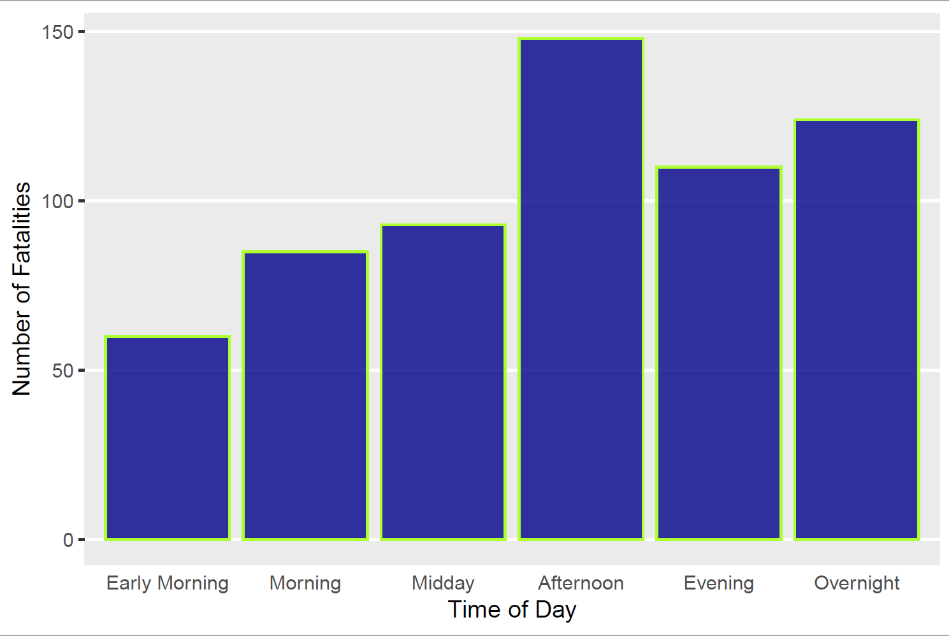
Fatalities by Time of Day
Notes:
When presenting, can share the times that correspond to each. Shows highest number during 3-6pm (ties in with hypothesis of more during evening rush hour window, which is generally around 4-6pm)

Slide 9
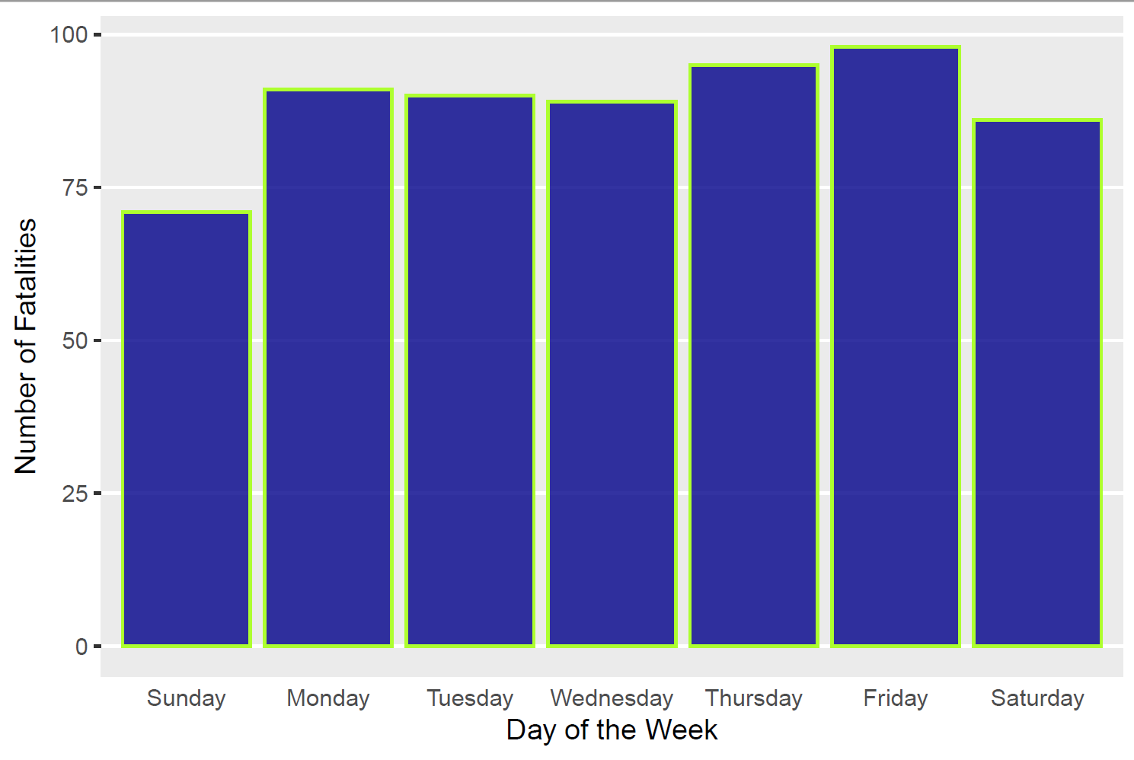
Fatalities by Day of the Week

Slide 10
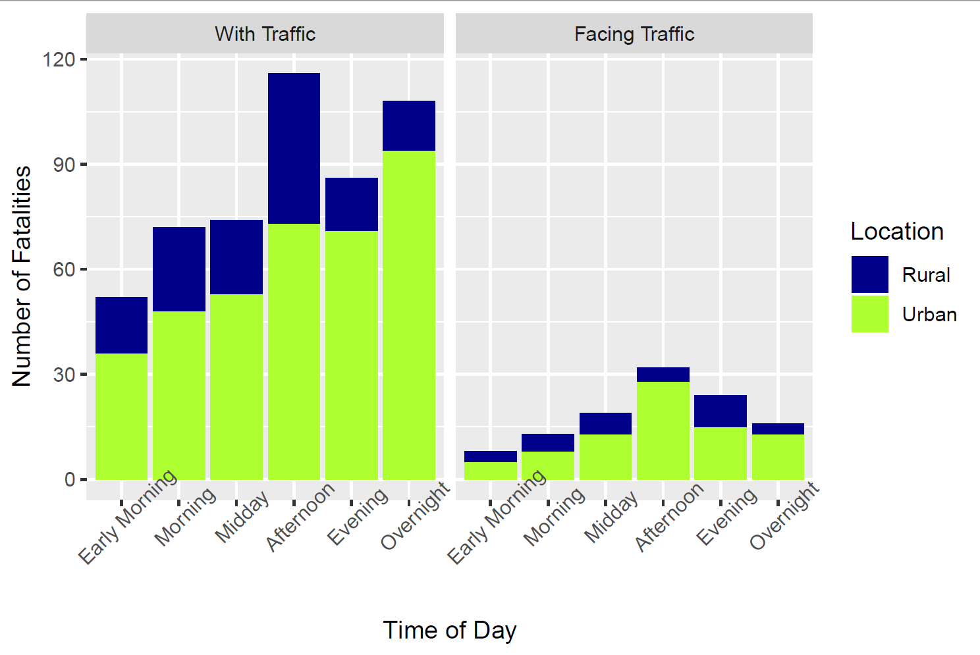
Fatalities by Time of Day, Type of Location, and Bicycle Direction
Notes:
Shows higher numbers in urban areas and many more when the bicycle is traveling the same direction as traffic

Slide 11
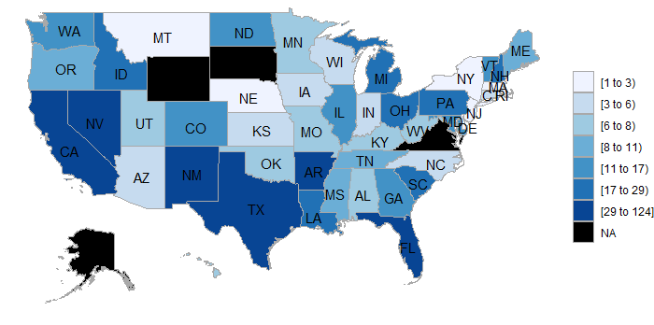
Fatalities by State

Slide 12
Fatalities by State – Top 5
State | Number of Fatalities in Data
California | 124
Florida | 119
Texas | 59
New York | 47
Arizona | 33
State | Population
California | 39.7 M
Texas | 29.0 M
Florida | 21.6 M
New York | 19.5 M
Pennsylvania | 12.8 M
VS.
Notes:
This correlates with our hypothesis that more urban areas are susceptible to bicycle crashes.

